Slide 1

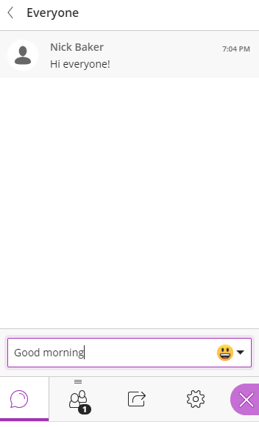




Welcome to the Virtual Classroom
Use Google Chrome NOT Internet Explorer, Safari, etc.
Chat
Click to open chat and other controls
Session controls:
Settings
Mic
Camera
Raise hand
Using the whiteboard
Welcome to Virtual Classroom by Nick Baker & Nobuko Fujita is licensed under a Creative Commons Attribution 4.0 International License.
Notes:
Check participants can hear, type something in the chat, raise hand etc. Also a reminder they should be in Google Chrome
Adapted from Nick Baker’s slide

Slide 2
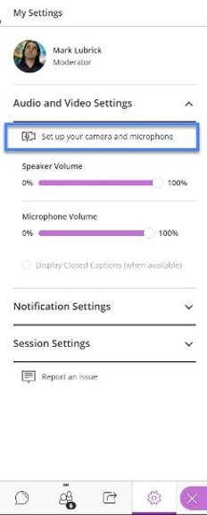
Audio/Video Check
Click on…​
Purple arrows at bottom right ​
Settings (gear)​
Set up your camera and microphone
Notes:
Another example of first slide, copy & pasted from ETE19
Enter in poll
How are you, really?
Fine
Good
So-so
Meh
Awful

Slide 3

Notes:
Ask students to use the whiteboard tools to trace their way to the centre of the labyrinth. This one is a classical 7 circuit labyrinth, approx. 4000 years old. Adapted from diagram by Lars Howlett for the Labyrinth Society https://labyrinthsociety.org/about-labyrinths
Example of an activity that online teachers can use to help students focus and prepare themselves for an online live class.
Labyrinth is an international image, and suitable for all students regardless of the faiths they practice, or cultures and communities of which they are members.
(Sellers and Moss, 2016)
Brock U has a physical one, see photo at https://brocku.ca/brock-news/2019/05/new-labyrinth-to-provide-space-for-reflection/
And resources https://brocku.ca/pedagogical-innovation/resources/the-brock-university-labyrinth/ including
Jill Grose’s video for drawing a labyrinth https://echo360.ca/media/c43e56ea-e08c-4f8a-be66-7075247d9f0b/public

Slide 4

Building Learning Community Online
Nobuko Fujita, PhD
Slides will be available in the
Online Course Design Lab
Blackboard organization site
Notes:
Acknowledge slides adapted from Nick & Nobuko’s Odette workshop slides

Slide 5
Overview
Community of learners
Engaging online students in learning activities
Assignments
Questions

Slide 6
Icebreaker Activity
To introduce you to the instructor, to the technology, and the workshop
Notes:
Paste in chat https://padlet.com/nfujita/5izlkcgcx6eoxs23

Slide 7
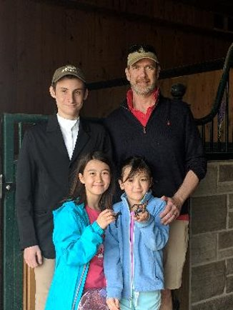

Who am I?
Online learning specialist
Educational developer
Educational researcher
Learning scientist
Academic spouse & mother
Notes:
From ETE19, copy & paste wrecked formatting
nline Learning
Online Learning Specialist​
Educational Developer​
Educational Researcher​
Learning Scientist​
Mother and spouse​
Horsewoman

Slide 8
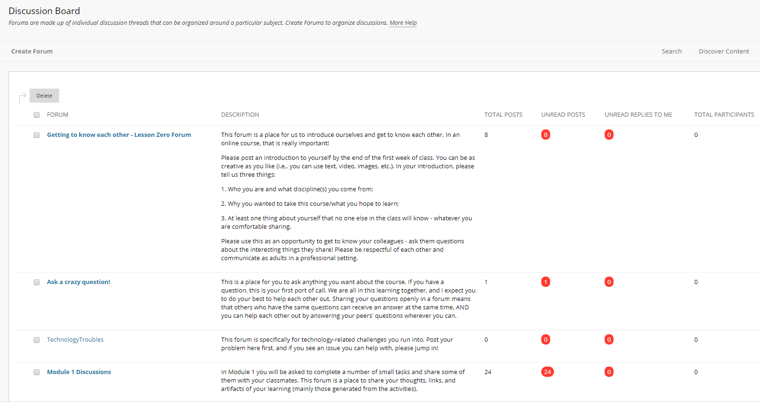
Asynchronous communication & learning
Notes:
Adapted from Nick Baker’s slide

Slide 9
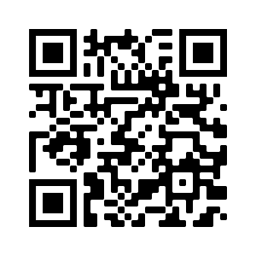
Icebreaker Activity
To introduce you to the instructor, to the technology, and the workshop
Click on link in the chat to open a Padlet (opens in another Chrome tab)
Notes:
Paste in chat https://padlet.com/nfujita/5izlkcgcx6eoxs23

Slide 10

Community of Learners

Slide 11
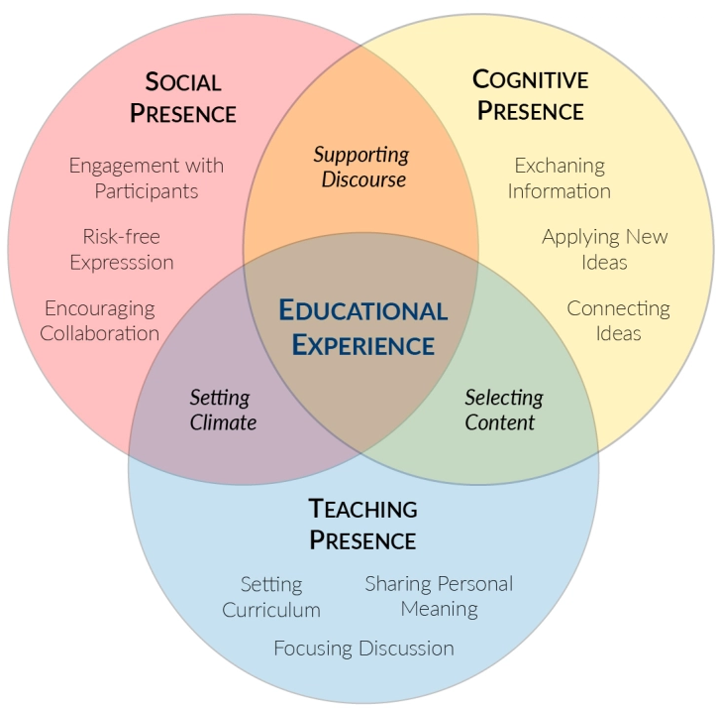
Community of Inquiry Model
(Garrison, Anderson and Archer, 2000)
Image: Broda, 2018 https://modelelearning.com/2018/08/28/communities-of-inquiry-coi-teaching-presence/
Notes:
Adapted from Nick Baker’s slide

Slide 12
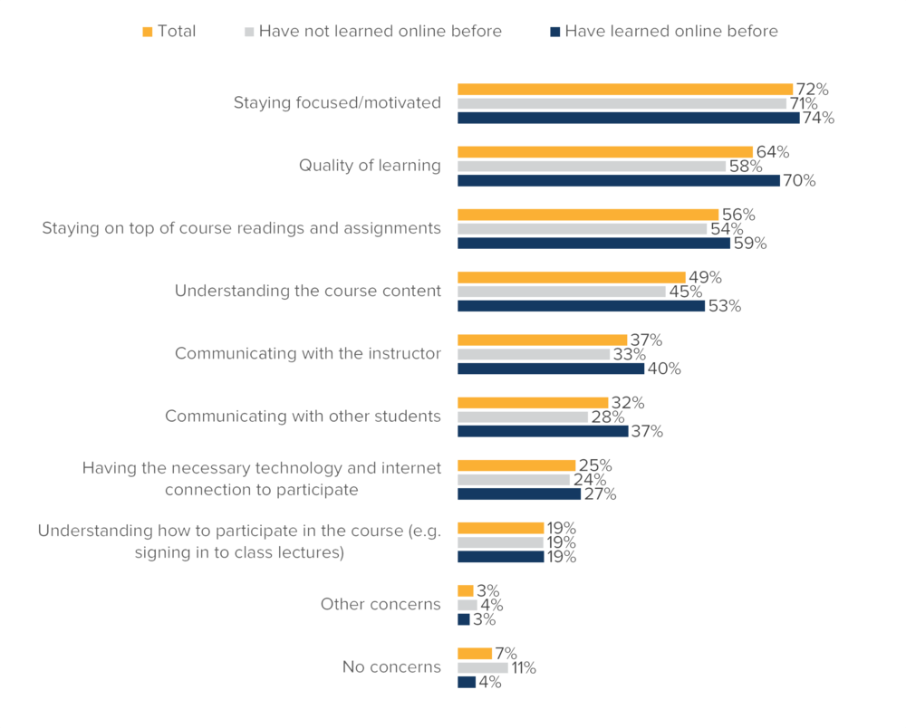
Key student concerns for online learning in Fall 2020
Source: Academica, 2020 https://forum.academica.ca/forum/current-students-covid19
Notes:
Adapted from Nick Baker’s slide
Prior to COVID-19, only half of all surveyed students had participated in any form of online or distance education (50%), a figure that was slightly higher among university students than college students (53% vs 44%). In short, the move to online learning this term was the first experience many students, especially college students, had with online education.
Students’ concerns about taking classes online are largely related to whether they feel they can learn online and whether their institution will be able to provide the same quality of education online. Many students say they are concerned about staying focused or motivated (72%), the quality of learning they will receive (64%), staying on top of course readings and assignments (56%), understanding course content (49%), and communicating with their instructors (37%).
While these concerns didn’t differ greatly between college and university students, we noticed a marked difference between those who had participated in online learning in the past and those who had not.

Slide 13
Cognitive Presence
Teacher Presence
Social Presence
Source: Academica, 2020 https://forum.academica.ca/forum/current-students-covid19
Notes:
https://forum.academica.ca/forum/current-students-covid19
Adapted from Nick Baker’s slide

Slide 14

Remember: Students may not have great
computer or
network
Notes:
Image borrowed from OOL Teams, need to find source; coffee cup holder

Slide 15
Asynchronous vs Synchronous
Announcements, email, messages, discussion forums
Low bandwidth
Work at own pace
Low pressure
Good for collaboration, communication, in different time zones, working, parenting, sick, rural and remote, poor internet access
Virtual classroom, MS Teams
High bandwidth required
Everyone has to be available at the same time
High pressure
Good for real-time collaboration, demonstrating complex concepts, software, dialogue
Notes:
Adapted from Nick Baker’s slide

Slide 16
2. Engaging online students

Slide 17
What is quality teaching?
Write on me

Slide 18
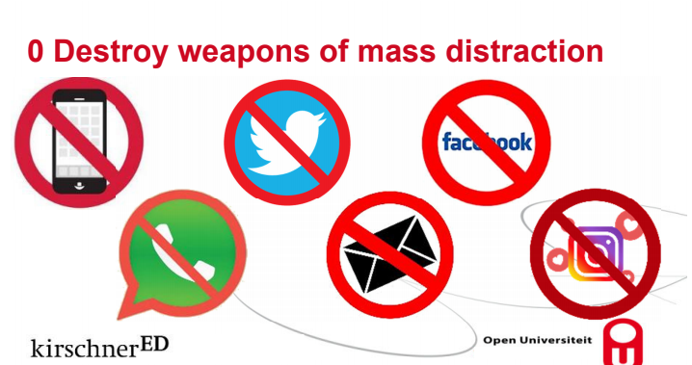
https://bit.ly/2WziavY
Notes:
Paul Kirschner’s (2020) slide https://bit.ly/2WziavY
Watch his Youtube, he is HUGE in educational psychology and one of my mentors

Slide 19
Course Content
-beyond PowerPoint lectures (pre-recorded or live)
- open textbooks and OER

Slide 20
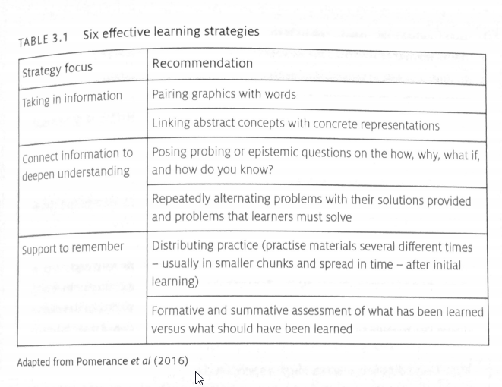
6 Effective Learning Strategies
(Source: Neelen & Kirschner, 2020, p. 59)
Notes:
Using a scanner app for assessments (by Nobuko & Nick; handout for students and faculty) https://drive.google.com/open?id=1B8MvyE5ar2pSHkjyBMd4xYeZ2HE2jNcDLZR75a0xQ6E
Highly recommend this book https://www.koganpage.com/product/evidence-informed-learning-design-9781789661415 for LDs, IDs

Slide 21
3. Assessments

Slide 22
What online assignments will you use?
Write on me

Slide 23

Contact
Nobuko Fujita, PhD Learning Specialist
nfujita@uwindsor.ca
@nobukofujita

Slide 24
References
Garrison, D. R., Anderson, T., & Archer, W. (2000). Critical inquiry in a text-based environment: Computer conferencing in higher education. The Internet and Higher Education, 2(2-3), 1-19. Retrieved from https://www.researchgate.net/publication/222474115_Critical_Inquiry_in_a_Text-Based_Environment_Computer_Conferencing_in_Higher_Education

